Slide 1

Insuretech Data & Analytics Strategy
Dennis
Peters
Building the intelligence engine powering underwriting, claims, distribution, and investment performance.
1/10/2026

Slide 2


Table of Contents
Vision & Outcomes
Data Platform & Foundations
Core Analytics Pillars
Real-Time Business Visibility
Advanced Analytics & AI Use Cases
Predictive Analytics Algorithms
Operational Automation
What Success Looks Like
Operational Model & Roadmap
What Success Looks Like
4 Growth Opportunities for Insuretech
Closing

Slide 3
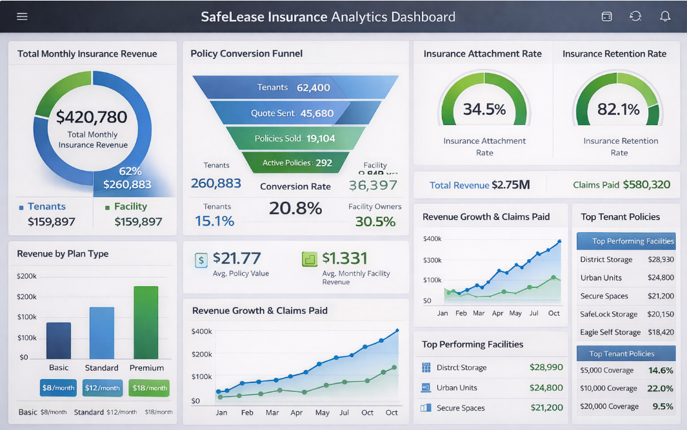
Vision & Outcomes
Enable growth, risk intelligence, and operational scale through data
Every key decision in product, underwriting, GTM, and capital deployment is data‑informed.
Target outcomes:
Improve loss ratios
Increase attach rates
Reduce claims cycle time
Strengthen partner relationships
Optimize capital allocation
Unlock new insurance and investment products
“This is business transformation, not a tech project.”
Assumptions:
This recommendation is based on limited information. The strategy will evolve once discovery is completed.

Slide 4
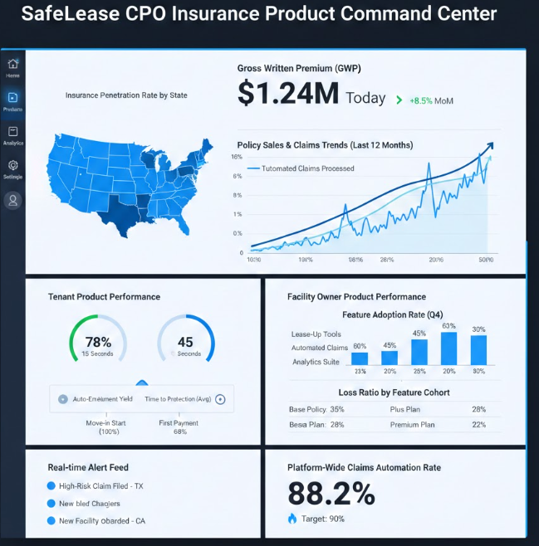
Data Platform & Foundations
Unified data model across:
Tenant & facility products (policies, premiums, claims).
Operators, facilities, PMS/FMS integrations, occupancy, rates.
External risk data (cat/weather, crime, property).
Real Estate Investments
Architecture: cloud warehouse / lakehouse with layers:
Raw → Cleansed → Curated domains (Insurance & Risk, Operators & Facilities, Tenants, GTM, Finance/Capital).
Governance & quality:
KPI dictionary (coverage rate, RPU, NOI uplift, loss ratio).
Data catalog, lineage, PII handling, role‑based access.

Slide 5
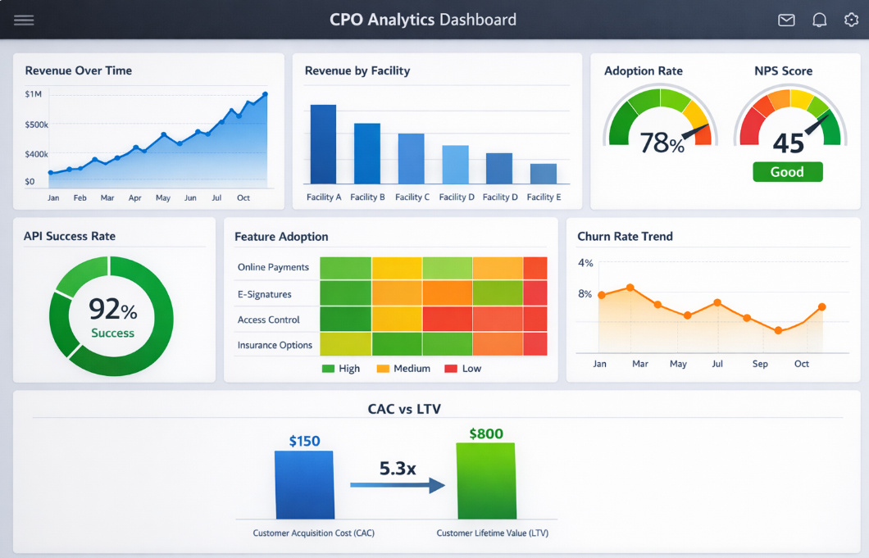
Core Analytics Pillars
Insurance & Risk Analytics
Pricing & underwriting models (expected loss, segment pricing).
Loss ratio, frequency/severity, claims SLAs feeding product and pricing decisions.
Operator & Facility Performance
Facility P&L: program revenue, RPU, NOI uplift vs baseline, claims.
Operator scorecards and benchmarking to guide CSM and product roadmap.
Product & GTM Analytics
Funnel: operator lead → signed → live → covered tenants.
Attach rates by channel/product; A/B testing of enrollment flows and Auto‑Protect.
Capital & Investment Analytics
Cohort/vintage profitability; stress tests and scenario analysis.
Inputs to reinsurance, capital allocation, and new structures.

Slide 6
Real‑Time Business Visibility
CEO‑level dashboards that answer:
How fast are we growing?
Where are we winning?
Where are we leaking value?
Which partners are outperforming?
What risks are emerging?
Insights move from monthly → daily → real‑time.
Goal: One source of truth, multiple perspectives.
Executive View | Operator / Product View
Revenue & growth trends | Facility-level performance
Loss ratio & risk exposure | Insurance uptake
Forecast vs actuals | Claims trends & anomalies

Slide 7
Advanced Analytics & AI Use Cases
Shift from reactive to proactive:
Predictive Models
Claim likelihood & severity
Tenant churn & LTV
Facility risk scoring
Prescriptive Insights
Pricing optimization
Coverage recommendations
Loss prevention opportunities
Model investment returns
Automation
Alerts for anomalies
Embedded insights in workflows
This is where Insuretech gains durable competitive advantage.

Slide 8
Predictive Analytics Algorithms
Objective | ML Algorithm/Technique | Rationale
Claim likelihood & severity | Gradient Boosting (XGBoost/LightGBM) + GLM for severity | Tabular insurance data excels with tree-based models; GLMs handle loss distributions well.
Tenant churn & LTV | Survival analysis (Cox PH) + Gradient Boosting for LTV | Time-to-event for churn, regression trees for monetary value prediction.
Facility risk scoring | Random Forest + SHAP for explainability | Multi-factor risk scoring with feature importance for underwriting transparency.
Pricing optimization | Reinforcement Learning or Bayesian Optimization | Dynamic pricing needs sequential decision-making; LLMs don't optimize continuous variables.
Coverage recommendations | Recommendation Systems (Collaborative Filtering) + XGBoost | Hybrid ML + LLM for tenant-specific coverage explanations and upsell copy.
Loss prevention opportunities | Anomaly Detection (Isolation Forest) + Time Series Forecasting | Detect unusual patterns in facility sensor/IoT data that predict losses.
Model investment returns | Monte Carlo Simulation + GARCH for volatility | Financial time series modeling for reinsurance and capital allocation scenario

Slide 9
Operational Automation
Data reduces manual work across the business:
Automated claims triage
Automated underwriting recommendations
Auto‑generated insights for sales and partners
Exception‑based workflows
Teams spend less time gathering data and more time acting on it.

Slide 10
What Success Looks Like
Claims cycle time drops
Loss ratios improve
Attach rates rise
Partner performance becomes transparent
Underwriting becomes more precise
Investment decisions become more data‑driven
Leadership has real‑time visibility into the business
Data becomes a force multiplier across Insuretech.

Slide 11
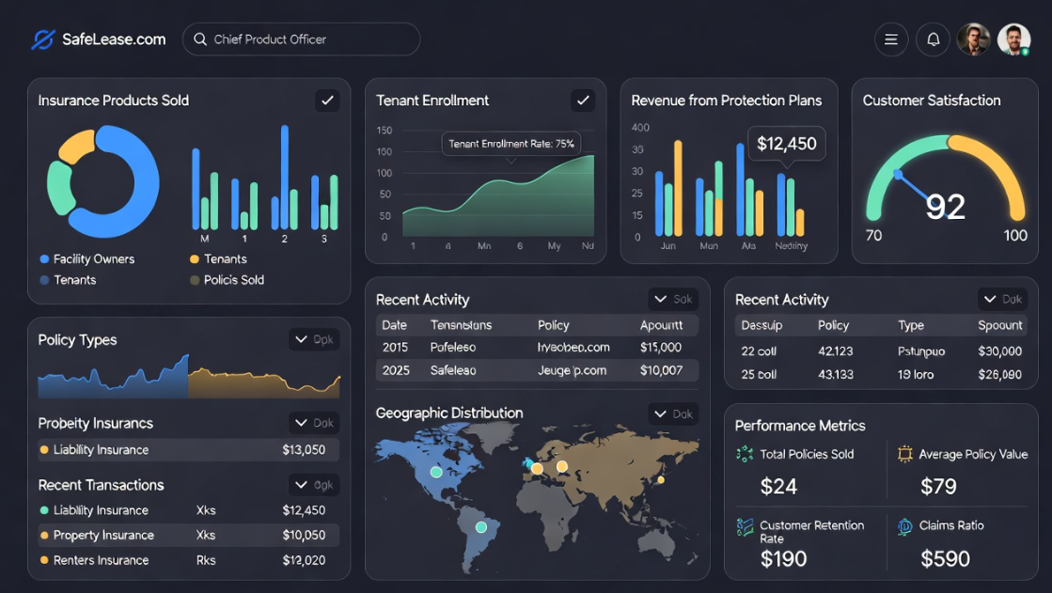
Operating Model & Roadmap
Operating model
Central data platform team (engineering, governance, core models).
Embedded analytics partners for Insurance, Product, GTM, and Finance.
Self‑serve layer: certified metrics, standard exec/CSM/product dashboards.
Roadmap (high level)
Phase 1: Land core data, define KPIs, build executive and CPO scorecards.
Phase 2: Domain models, operator/facility scorecards, first pricing & risk models, experimentation framework.
Phase 3: Customer‑facing analytics for operators, mature capital analytics, scaled experimentation and forecasting. Completed AI and ML models.

Slide 12
4 Growth Opportunities for Insuretech
1. Parametric Catastrophe Insurance for Facilities
Opportunity: Offer first‑dollar coverage that pays out automatically when predefined weather events hit (hurricane wind speed, flood depth, wildfire proximity). Why it works: Self‑storage facilities face unique climate risks (RV/boat damage, temporary closures). Insuretech's facility data + weather APIs = instant parametric triggers. Revenue: High‑margin, sticky ancillary product bundled with existing facility insurance.
2. Real Estate Investment Risk Analytics Platform
Opportunity: License Insuretech's facility risk scoring, loss forecasting, and NOI analytics as a SaaS product to REITs, developers, and property managers. Why it works: Self‑storage operators already trust Insuretech's data. Monetize analytics beyond insurance premiums. Revenue: Recurring SaaS revenue + deeper relationships with large operators.
3. Climate-Resilient Property Insurance Rider
Opportunity: Coverage for climate adaptation investments (green roofs, flood barriers, fire‑resistant materials) with premium discounts for verified mitigation. Why it works: Commercial property market demands climate risk solutions. Insuretech can verify IoT sensor data for discounts. Revenue: Premium product positioned as "future‑proofing" for facilities.
4. REIT Dividend Protection Insurance
Opportunity: Insure self‑storage REIT dividend payouts against occupancy drops or revenue shortfalls (tied to Insuretech's facility performance data). Why it works: REITs need income protection products. Insuretech has unique visibility into actual facility economics via tenant programs. Revenue: Institutional product with high limits, attractive to publicly traded operators.

Slide 13

Closing
Insuretech has the data.
Insuretech has the momentum.
Now it needs the platform — and the leadership — to turn that data into a competitive advantage.
This strategy does exactly that.
Thank you!

Slide 14
APPENDIX
Notes:
Leverage existing staff, to take on after built or learn new skills, offer as career growth,

Slide 15


Notes:
Python web frameworks - Fast API allows asynchronous calls, Flask gives move developer component flexibility. AWS & Azure deployed via Zip file / GCP requires docker image

